Slide 1


Who owns the dog?

Slide 2
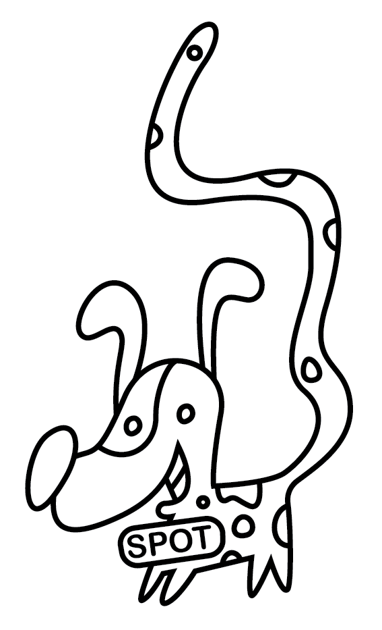



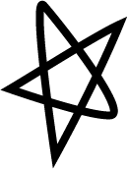
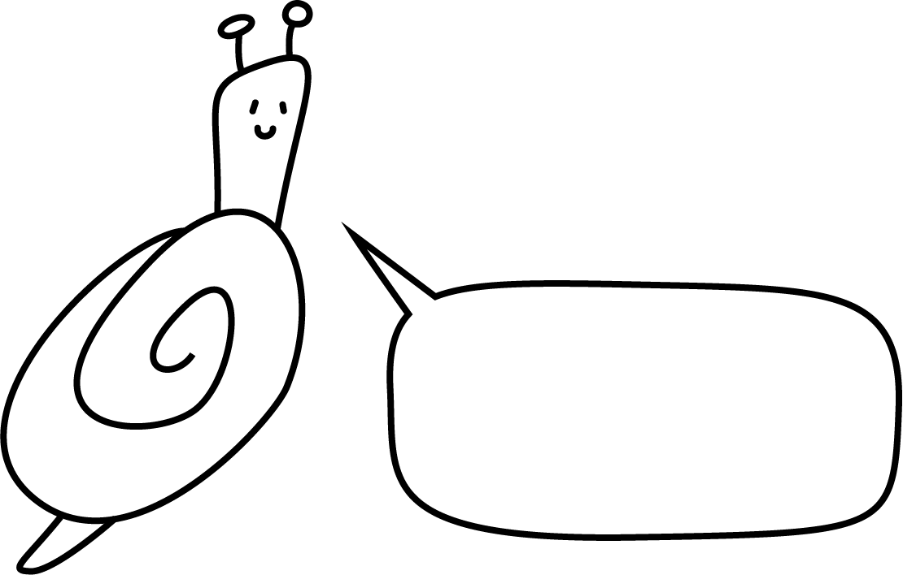
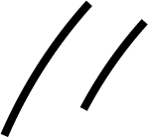














Who owns the dog?
Fact: Only one character owns the dog.
Fact: Everyone is telling the truth.
My dog wears glasses and has a triangle-shaped nose. He likes to tell jokes.
My dog's name starts with an 'S'. He has a short tail.
My dog has spots. He is called Spot. He never smiles.
My dog has a long tail and spots. He likes ice cream.

Slide 3

My dog wears glasses and has a triangle-shaped nose. He likes to tell jokes.

Slide 4
My dog has spots. He is called Spot. He never smiles.

Slide 5
My dog's name starts with an 'S’.
He has a short tail.

Slide 6



My dog has a long tail and spots.
He likes ice cream.

Slide 7

Fact: Only one character owns the dog.
Fact: Everyone is telling the truth.

Slide 8


Who owns the dog?
Fact: Only one character owns the dog.
Fact: Everyone is telling the truth.
My dog wears glasses and has a triangle-shaped nose. He likes to tell jokes.
My dog's name starts with an 'S'. He has a short tail.
My dog has spots. He is called Spot. He never smiles.
My dog has a long tail and spots. He likes ice cream.

